Slide 1
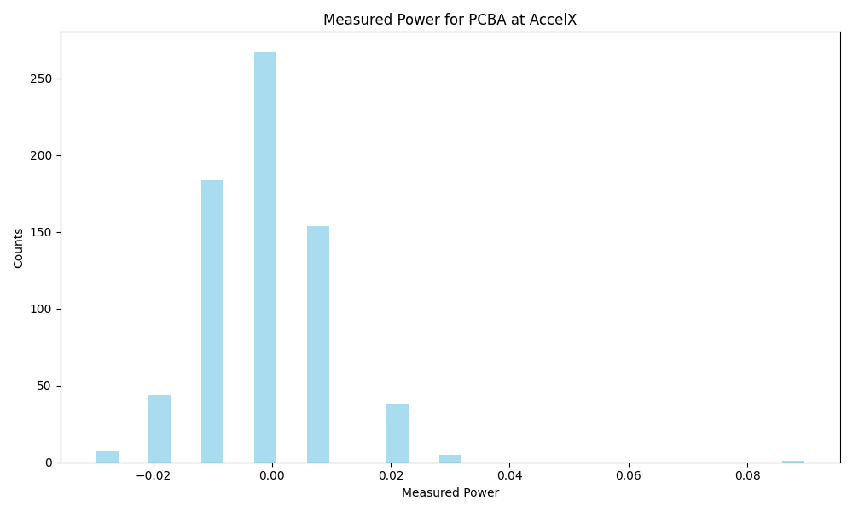
Frequency | Metric
Count | 700
Mean | -0.00
Std | 0.01
Min | -0.03
Max | 0.09

Slide 2
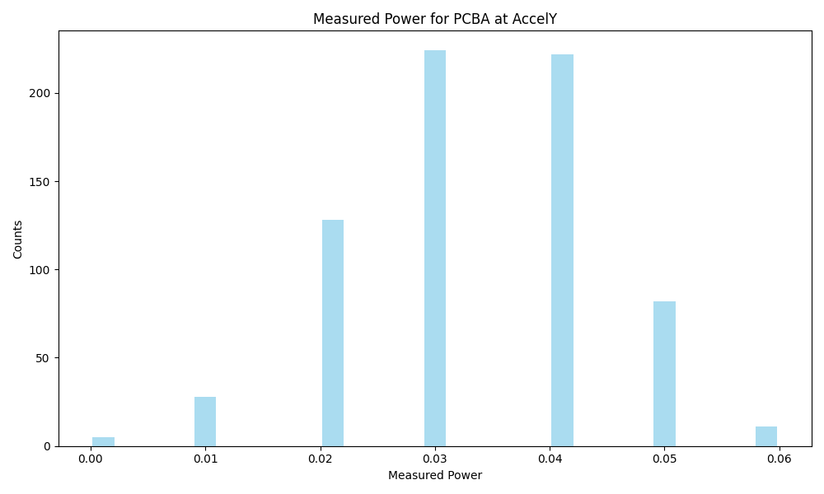
Frequency | Metric
Count | 700
Mean | 0.03
Std | 0.01
Min | 0.0
Max | 0.06

Slide 3
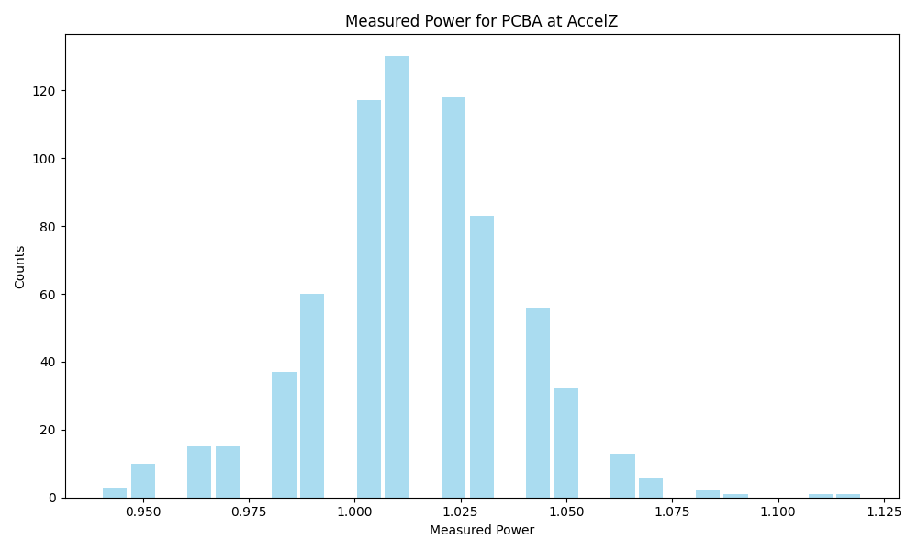
Frequency | Metric
Count | 700
Mean | 1.01
Std | 0.02
Min | 0.94
Max | 1.12

Slide 4
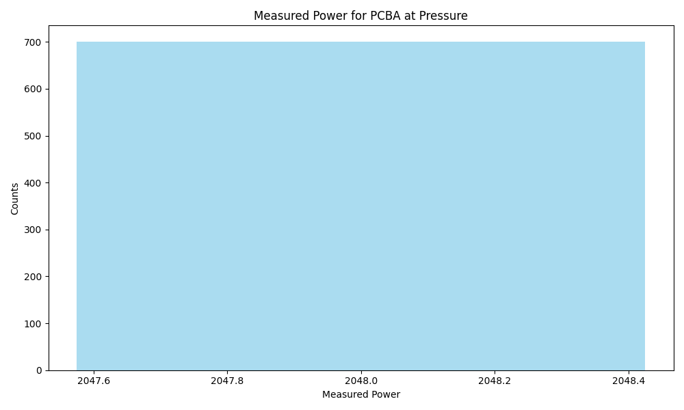
Frequency | Metric
Count | 700
Mean | 2048.00
Std | 0.00
Min | 2048.0
Max | 2048.0

Slide 5
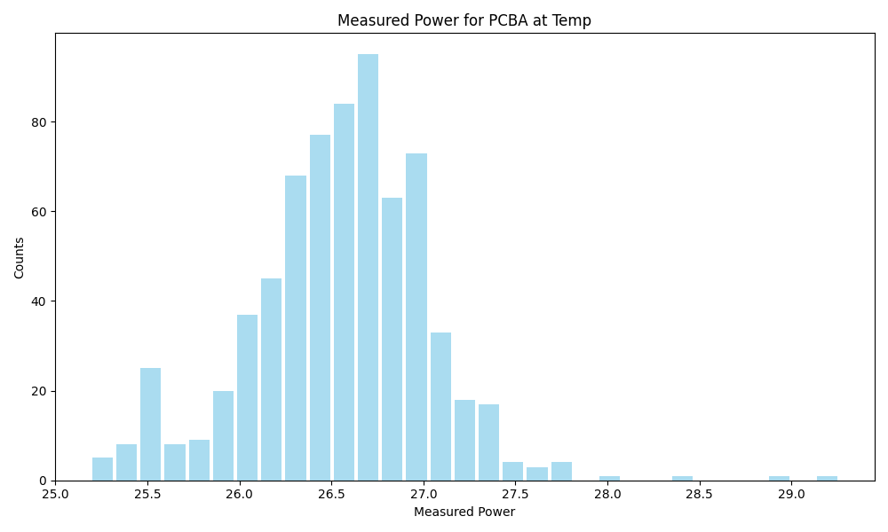
Frequency | Metric
Count | 700
Mean | 26.55
Std | 0.49
Min | 25.19
Max | 29.26

Slide 6
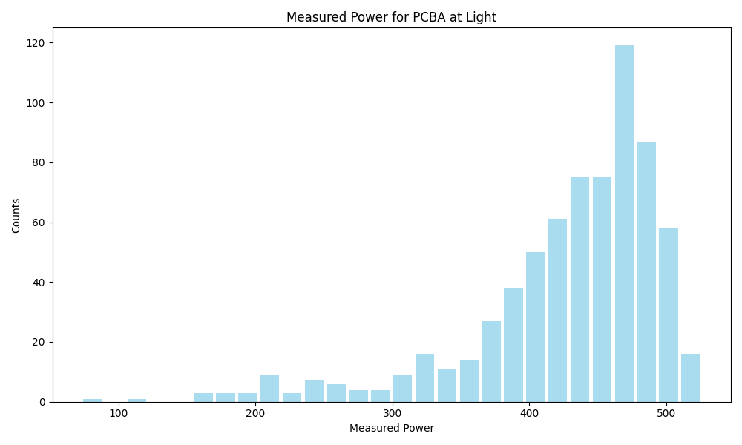
Frequency | Metric
Count | 700
Mean | 427.90
Std | 70.83
Min | 73.0
Max | 526.0

Slide 7
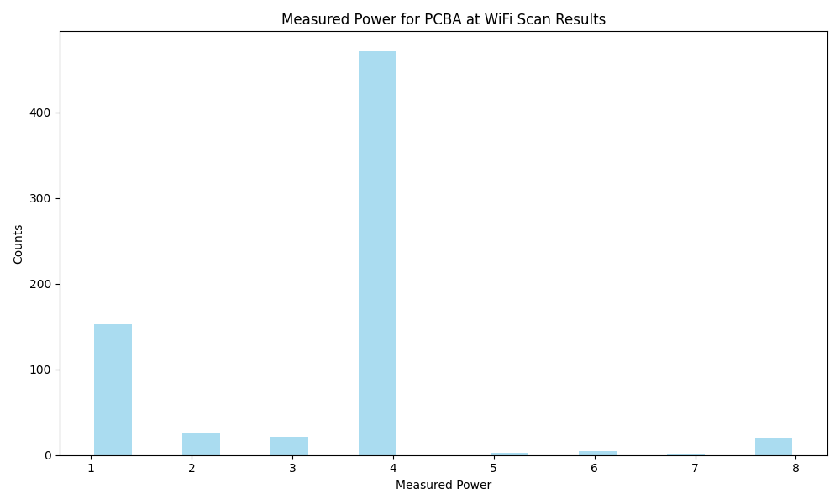
Frequency | Metric
Count | 700
Mean | 3.38
Std | 1.50
Min | 1
Max | 8

Slide 8
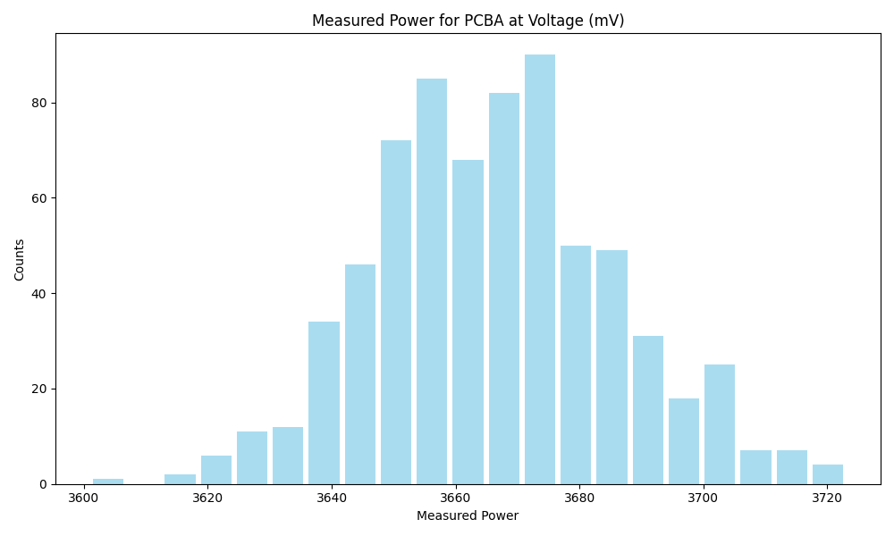
Frequency | Metric
Count | 700
Mean | 3666.21
Std | 19.61
Min | 3601.0
Max | 3723.0

